Slide 1
MIPS Instructions
Consider a comparison instruction:
slt $t0, $t1, $zero
and $t1 contains the 32-bit number 1111 01…01
What gets stored in $t0?

Slide 2
MIPS Instructions
Consider a comparison instruction:
slt $t0, $t1, $zero
and $t1 contains the 32-bit number 1111 01…01
What gets stored in $t0?
The result depends on whether $t1 is a signed or unsigned
number – the compiler/programmer must track this and
accordingly use either slt or sltu
slt $t0, $t1, $zero stores 1 in $t0
sltu $t0, $t1, $zero stores 0 in $t0

Slide 3
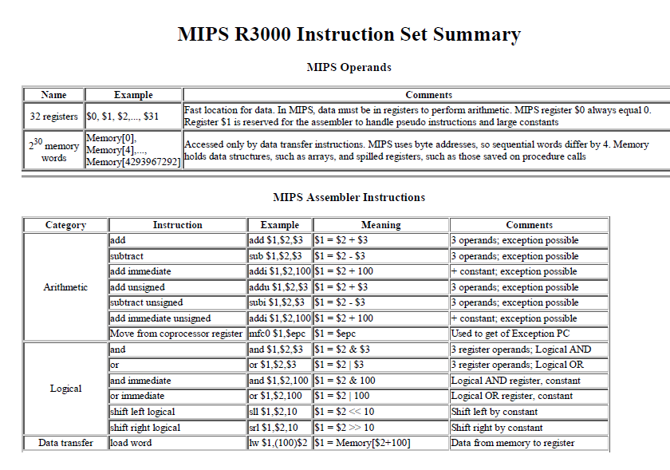

Slide 4
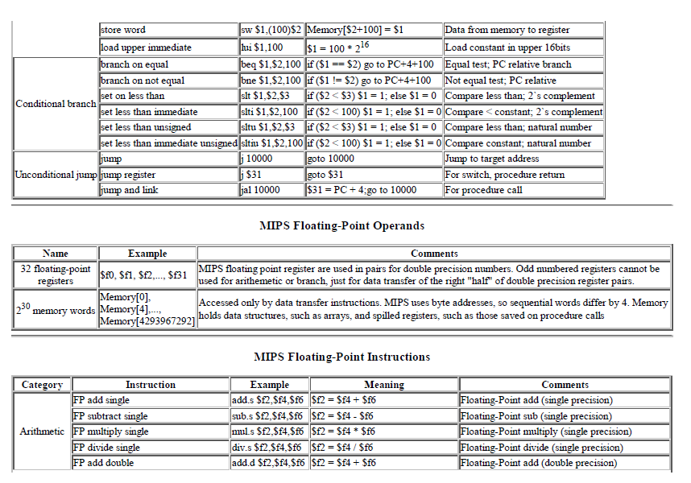

Slide 5
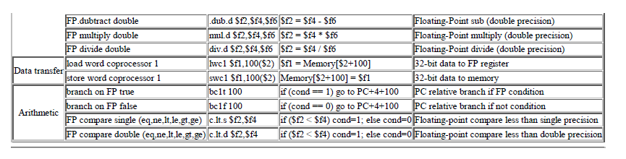

Slide 6
The Bounds Check Shortcut
Suppose we want to check if 0 <= x < y
and x and y are signed numbers (stored in $a1 and $t2)
The following single comparison can check both conditions
sltu $t0, $a1, $t2
beq $t0, $zero, EitherConditionFails
We know that $t2 begins with a 0
If $a1 begins with a 0, sltu is effectively checking the second condition
If $a1 begins with a 1, we want the condition to fail and coincidentally,
sltu is guaranteed to fail in this case

Slide 7
Sign Extension
Occasionally, 16-bit signed numbers must be converted
into 32-bit signed numbers – for example, when doing an
add with an immediate operand
The conversion is simple: take the most significant bit and
use it to fill up the additional bits on the left – known as
sign extension
So 2₁₀ goes from 0000 0000 0000 0010 to
0000 0000 0000 0000 0000 0000 0000 0010
and -2₁₀ goes from 1111 1111 1111 1110 to
1111 1111 1111 1111 1111 1111 1111 1110

Slide 8
Alternative Representations
The following two (intuitive) representations were discarded
because they required additional conversion steps before
arithmetic could be performed on the numbers
  sign-and-magnitude: the most significant bit represents
  +/- and the remaining bits express the magnitude
  one’s complement: -x is represented by inverting all
  the bits of x
  Both representations above suffer from two zeroes

Slide 9

Addition and Subtraction
Addition is similar to decimal arithmetic
For subtraction, simply add the negative number – hence,
subtract A-B involves negating B’s bits, adding 1 and A

Slide 10
Overflows
For an unsigned number, overflow happens when the last carry (1)
cannot be accommodated
For a signed number, overflow happens when the most significant bit
is not the same as every bit to its left
  when the sum of two positive numbers is a negative result
  when the sum of two negative numbers is a positive result
  The sum of a positive and negative number will never overflow
MIPS allows addu and subu instructions that work with unsigned
integers and never flag an overflow – to detect the overflow, other
instructions will have to be executed

